Slide 1
Java – Prototype Design Patterns

Slide 2
Prototype Pattern
A creational pattern
Specify the kinds of objects to create using a prototypical instance, and create new objects by copying this prototype
When to use Prototype pattern
When product creation should be decoupled from system behavior
When to avoid subclasses of an object creator in the client application
When creating an instance of a class is time-consuming or complex in some way.
When instances of a class can have one of only a few different combinations of state. It may be more convenient to install a corresponding number of prototypes and clone them rather than instantiating the class, each time with the appropriate state.

Slide 3
Prototype Pattern- Motivation
Sometimes, it becomes necessary to copy or clone an “already grown” object rather than instantiating it and setting its values.
Consider the case of Photoshop. A graphics designer add an image to the canvas. Then, he adds a border to it. Then, he gives it a bevel effect. Finally, he sets its transparency to 50%. Now, he selects this image, presses Ctrl + C , and press Ctrl + V 5 times.
What will happen? The same image will be pasted 5 times. So, there will be 6 identical images on the canvas at different locations.
How will you achieve this programmatically? New object from scratch at client side? Use a factory?
Prototype patterns is the solution here.

Slide 4
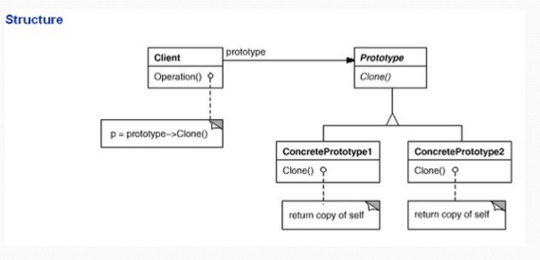
Prototype - Structure
Structure

Slide 5
Prototype- Participant
Prototype
Declares an interface for cloning itself.
ConcretePrototype
Implements an operation for cloning for itself.
Client
Creates a new object by asking a prototype to clone itself.

Slide 6
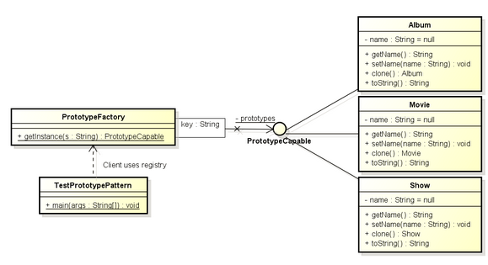
Prototype – Problem
Create an entertainment application that will require instances of Movie, Album and Show classes very frequently. I do not want to create their instances every time as it is costly. So, I will create their prototype instances, and every time when i will need a new instance, I will just clone the prototype.

Slide 7

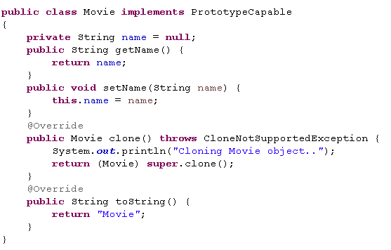
Prototype - Solution
Solution
PrototypeCapable
Movie

Slide 8
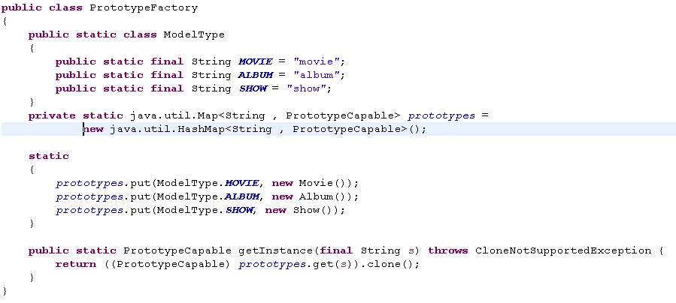
Practice
Create two other classes Album and show as per the class diagram in upper slides.
Create ProtoTypeFactory class-

Slide 9
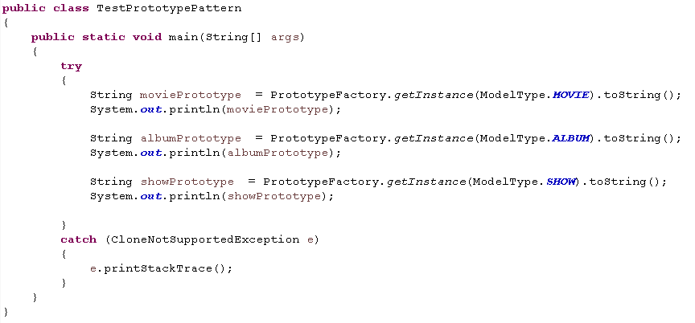
Test
Below is the test class

Slide 10
Prototype - Consequnces
Prototype has many of the same consequences that Abstract Factory and Builder have. It hides the concrete product class from the client, thereby reducing the number of names of clients know about. Moreover, these patterns let a client work with application-specific classes without modification.
Reducing sub classing. Factory method often produces a hierarchy of Creator classes. Prototype patterns lets you clone a prototype instead of asking a factory method to make a new object. Hence you don’t need a Creator class hierarchy at all..
Configuring an application with classes dynamically. Some run-time environments let you load classes into an application dynamically.
Additional benefits of the prototype patterns are-
Adding and removing products at run-time. Prototypes let you incorporate a new concrete product class into a system simply by registering a prototypical instance with the client.
Specifying new objects by varying values. Highly dynamic systems let you define new behavior through object composition- by specifying values for an object’s variables, You effectively define new kinds of objects by instantiating existing class and registering the instances as prototypes of client objects.
Specifying new objects by varying structures. Many application build objects from parts and subparts.

Slide 11
Prototype- Flaws
The main liability of the Prototype pattern is that each subclass of Prototype must implement the Clone operation, which may be difficult.
Implementing Clone can be difficult when their internals include objects that don’t support copying or have circular references.

Slide 12
THANK YOU

